Slide 1
Mouse PK study: PK parameters
Compound: MMV025100; Batch ID: MMV025100-02
 | PK analysis
 | Route: IV | Dose: | 1 | mg/kg
Parameters | Description | Units | M4 | M5 | M6 | Mean | SD
Lambda_z | Kel | 1/hr | 1.82 | 1.46 | 1.52 | 1.60 | 0.19
HL_Lambda_z | T-half | hr | 0.38 | 0.48 | 0.46 | 0.44 | 0.05
Cmax | Cmax | ug/mL | 0.30 | 0.32 | 0.25 | 0.29 | 0.04
C0 | C0 | ug/mL | 0.60 | 0.49 | 0.34 | 0.48 | 0.13
AUClast | AUC0-t | hr*ug/mL | 0.11 | 0.13 | 0.13 | 0.12 | 0.01
AUCINF_obs | AUC0-∞ | hr*ug/mL | 0.11 | 0.14 | 0.13 | 0.13 | 0.01
AUC_%Extrap_obs | % AUC extrapolated (t-∞) | % | 1.31 | 3.03 | 3.65 | 2.67 | 1.21
AUC_%Back_Ext_obs | % AUC extrapolated (0-5min) | % | 33.68 | 24.93 | 18.54 | 25.72 | 7.60
Cl_obs | Clearance | mL/min/kg | 150.48 | 123.40 | 126.40 | 133.43 | 14.85
AUMClast | AUMC0-t | hr*hr*ug/mL | 0.03 | 0.04 | 0.05 | 0.04 | 0.01
AUMCINF_obs | AUMC0-∞ | hr*hr*ug/mL | 0.03 | 0.05 | 0.06 | 0.05 | 0.02
MRTlast | MRT | hr | 0.25 | 0.32 | 0.40 | 0.32 | 0.08
Vss_obs | Vdss | L/kg | 2.50 | 2.87 | 3.66 | 3.01 | 0.59
AUC (0-5)min | Partial AUC (0-0.0833hr) | hr*ug/mL | 0.037 | 0.034 | 0.024 | 0.032 | 0.007
Tlast | Tlast | hr | 2.00 | 2.00 | 2.00 | 2.00 | 0.000
Cmin_observed | Cmin_observed | ug/mL | 0.0027 | 0.0060 | 0.0073 | 0.0053 | 0.002
Cmax/Cmin | Cmax-Cmin ratio | NA | 113.2 | 53.3 | 33.8 | 66.8 | 41.4
 | Route: PO | Dose: | 3 | mg/kg
Parameters | Description | Units | M1 | M2 | M3 | Mean | SD
Lambda_z | Kel | 1/hr | 0.82 | 0.91 | 0.85 | 0.86 | 0.05
HL_Lambda_z | T-half | hr | 0.85 | 0.76 | 0.82 | 0.81 | 0.04
Tmax | Tmax | hr | 0.50 | 0.17 | 0.17 | 0.28 | 0.19
Cmax | Cmax | ug/mL | 0.03 | 0.14 | 0.07 | 0.08 | 0.06
AUClast | AUC0-t | hr*ug/mL | 0.04 | 0.10 | 0.08 | 0.07 | 0.03
AUCINF_obs | AUC0-∞ | hr*ug/mL | 0.04 | 0.10 | 0.08 | 0.08 | 0.03
AUC_%Extrap_obs | % AUC extrapolated (t-∞) | % | 3.51 | 1.53 | 2.42 | 2.49 | 0.99
Cl_F_obs | Clearance | mL/min/kg | 1145.43 | 506.14 | 597.98 | 749.85 | 345.65
AUC(0-5)min | Partial AUC (0-0.0833hr) | hr*ug/mL | 0.00061 | 0.00331 | 0.00262 | 0.00218 | 0.00140
Tlast | Tlast | hr | 4.00 | 4.00 | 4.00 | 4.00 | 0.000
AUC_%Back_Ext_obs | % AUC extrapolated (0-5min) | % | 1.403 | 3.348 | 3.138 | 2.63 | 1.07
Cmin_observed | Cmin_observed | ug/mL | 0.0013 | 0.0014 | 0.0017 | 0.001 | 0.000
Cmax/Cmin | Cmax-Cmin ratio | NA | 21.60 | 100.00 | 41.86 | 54.49 | 40.70
%BA_{0-t} | %BA_{0-t} | % | 11.47 | 26.48 | 22.21 | 20.05 | 7.74
%BA_{0-∞} | % F | % | 11.56 | 26.16 | 22.14 | 19.95 | 7.54

Slide 2
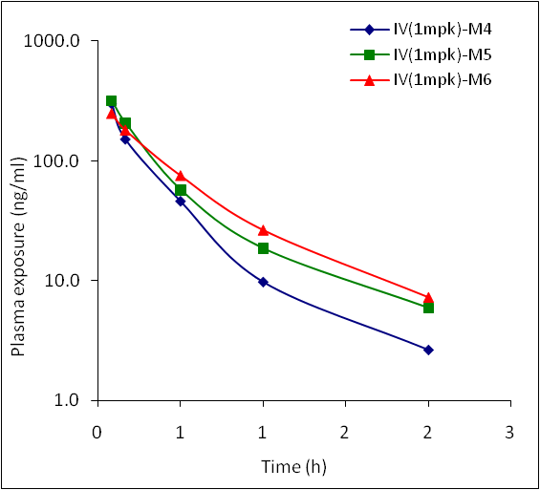
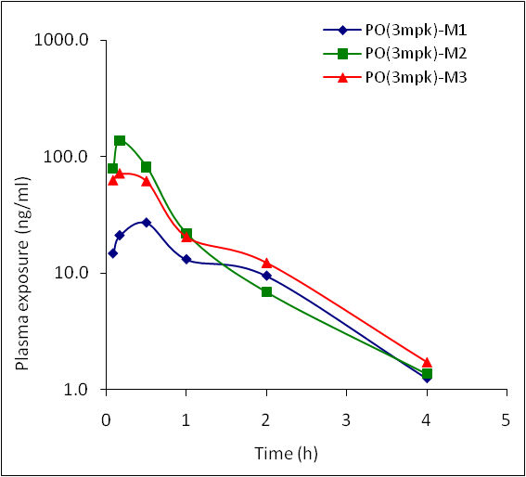
Mouse PK study: Plasma exposures
Compound: MMV025100; Batch ID: MMV025100-02
Plasma Exposure
Plasma exposure (ng/ml)
Time (h) | IV(1mpk) |  |  | Time (h) | PO(3mpk)
 | IV(1mpk)-M4 | IV(1mpk)-M5 | IV(1mpk)-M6 |  | PO(3mpk)-M1 | PO(3mpk)-M2 | PO(3mpk)-M3
0.08333 | 300.0 | 318.0 | 247.0 | 0.0833 | 14.7 | 79.4 | 63.0
0.166 | 152.0 | 207.0 | 180.0 | 0.166 | 21.0 | 137.0 | 72.0
0.5 | 46.2 | 57.6 | 75.2 | 0.5 | 27.0 | 81.6 | 61.9
1 | 9.8 | 18.7 | 26.5 | 1 | 13.1 | 21.9 | 20.5
2 | 2.7 | 6.0 | 7.3 | 2 | 9.5 | 6.9 | 12.3
4 | 0.0 | 0.0 | 0.0 | 4 | 1.3 | 1.4 | 1.7
8 | 0.0 | 0.0 | 0.0 | 8 | 0.0 | 0.0 | 0.0
24 | 0.0 | 0.0 | 0.0 | 24 | 0.0 | 0.0 | 0.0
Data points selected for the terminal fit

Slide 3
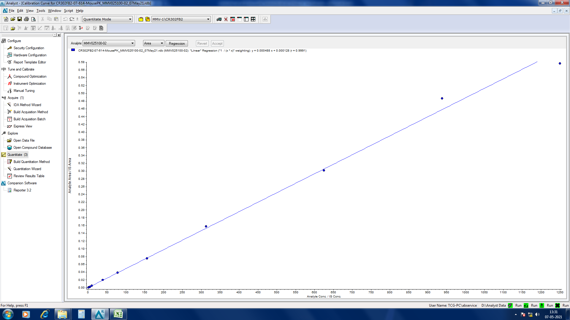
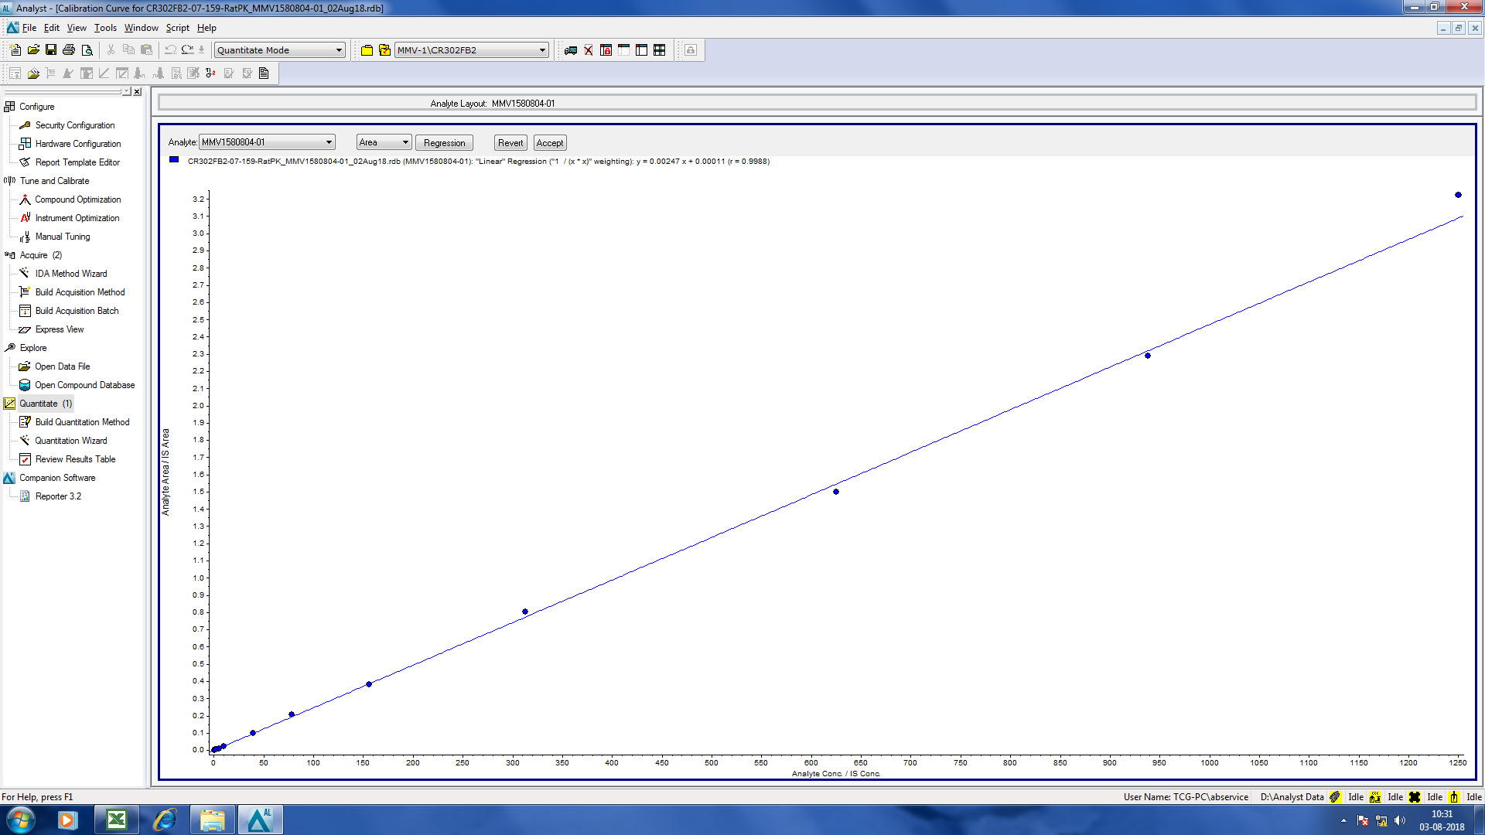
Mouse PK study: QC Summary
Compound: MMV025100; Batch ID: MMV025100-02
Regression of Calibration Controls
Curve fitting:
Curve fitting: | Linear regression (Weighting: 1/x*x)
Regression Coefficient | 0.9991
Slope | 0.000488
Intercept | 0.000128
QC result summary
Description | Sample Name | Sample Type | Accuracy(%)
Linearity | MMV025100-02=1.22ppb | Standard | 101.0
 | MMV025100-02=2.44ppb | Standard | 102.0
 | MMV025100-02=4.88ppb | Standard | 92.8
 | MMV025100-02=9.76ppb | Standard | 98.3
 | MMV025100-02=39.1ppb | Standard | 103.0
 | MMV025100-02=78.1ppb | Standard | 101.0
 | MMV025100-02=156ppb | Standard | 99.0
 | MMV025100-02=313ppb | Standard | 103.0
 | MMV025100-02=625ppb | Standard | 98.9
 | MMV025100-02=938ppb | Standard | 106.0
 | MMV025100-02=1250ppb | Standard | 94.4
QC & DQC, Set-1 | LQC=3.66ppb | Quality Control | 91.1
 | LQC=7.32ppb | Quality Control | 93.6
 | DQC=2500ppb_10x | Quality Control | 101.0
 | HQC=469ppb | Quality Control | 95.8
 | HQC=833ppb | Quality Control | 95.5
QC & DQC, Set-2 | LQC=3.66ppb | Quality Control | 93.6
 | LQC=7.32ppb | Quality Control | 91.4
 | DQC=2500ppb_10x | Quality Control | 93.6
 | HQC=469ppb | Quality Control | 91.3
 | HQC=833ppb | Quality Control | 89.6
QC & DQC, Set-3 | LQC=3.66ppb | Quality Control | 92.8
 | LQC=7.32ppb | Quality Control | 91.1
 | DQC=2500ppb_10x | Quality Control | 95.8
 | HQC=469ppb | Quality Control | 91.3
 | HQC=833ppb | Quality Control | 92.6

